Slide 1


Savitribai Phule Pune University, Pune Amrutvahini College Of Engineering, Sangamner Department of E&TC Engineering A Presentation on
“Voice operated lift control system with safety”
Presented By
1.Bhoknal Gayatri Satish(Roll no.07) 2.Varpe Aditya Rajendra(Roll no.66) 3.Waman Onkar Uttam (Roll no.69) 4.Zanjare Shaileshumar Gangaram(Roll no.72)
Under the Guidance of
Prof. V. R. Aware

Slide 2
Contents
Introduction
Need of project
Research motivation
Aim and objective of project
Literature Survey
Problem Statement (Title of Project)
Block Diagram of Project
Explanation of Block Diagram
Flow chart
Conclusion
References

Slide 3
Introduction
Blind people face many problems every day. One of these challenges is the use of elevators in many buildings. visually impaired should be able to enjoy using the elevator easily. Chapter To overcome this challenge for the blind, we must focus on the following issues: Make sure the blind person is at the elevator door Chapter Accept the idea of ​​getting down for the blind person Chapter Attention coming into the elevator from the seat of the blind person [2].
Speech is the superior personality of the human beings gifted by the nature. Speech helps to deliver the thoughts and messages between human. Speech recognition is the process of the computer recognizing human speech to generate a string of words or commands. Sometimes it is known as automatic speech recognition. Speech recognition is becoming more perplexing and difficult task. The speech recognition research is focuses mainly on large vocabulary, continuous speech capabilities and speaker independence. The design of speech recognition requires cautious attention to some issues like speech representation, depiction of various types of speech Classes, techniques, and database and performance evaluation [3].
A voice-operated elevator system is proposed where the user’s input commands to control the movement of the elevator system are kept convenient for the users. The commands include voice input for the floor operations, directions, elevator car’s door operation, and a special option to place a call of speaker’s choice in case of any unexpected event that requires immediate action [4].

Slide 4
Need Of Project
The blind people cannot use the elevator easily. It is difficult to use the keypad if they cannot see it. Sometimes the keypad has Braille technique, but they will have hard time for locating its place. Even though they found the keypad, how can they know the number if they do not know Braille? The struggle of the blind people using elevators is real. They always need help in elevators from someone to press the button for them and to tell them when the elevator cabin arrives. Also, it is hard for them to know the elevator door is opening or closing. Not that only, but in case of emergency how they will act if there is no one with them to help . So voice-controlled elevator can be a very good option for this people. One more drawback of the current lift is that it cannot tell on which floor the lift is stuck, nor the parameters like temperature of motor, fire detection inside the lift.But by using this voice operated lift we can solve all these problems. Also there is need toobserve real-time status of lift parameters.

Slide 5
Research Motivation
Our project is all about saving lives on the road. We want to use technology to prevent accidents and minimize their impact when they happen.
We've integrated various sensors to monitor things like vehicle speed, tire pressure, driver sobriety, seat belt usage, and driver alertness.
If an accident occurs, our system immediately alerts nearby hospitals and emergency services using GPS and GSM. We believe that with this system, we can make roads safer and protect drivers and passengers.

Slide 6
Aim of the Project:
The aim of this project is design and development of a voice-controlled lift/elevator control system with enhanced security features for human-machine communication.
Objectives of the Project:
1. To operate lift through voice commands with easy use for people with visual and
physical challenges.
2. To measure parameters like floor number, weight of the lift, fire detection,
temperature of motor, etc.
3. To give real time information of lift parameters on the webpage and sending
emergency alert on respective webpage.

Slide 7
Literature survey
SR.NO. | Title Of Research Paper | Author Name | Published Year | Proposed System
1 | Vehicle Accident Detection and Alert System Using Atmega 2560 Microcontroller | Sharmila S. Gaikwad, Mahek Khanna, Ashutosh Kudale | Computer Science | This system uses an Atmega 2560 microcontroller, IR sensor, pressure sensor, DS18B20 temperature sensor, alcohol sensor, IR seat belt sensor, eye blink sensor, ADXL345 accelerometer, and flex sensor to detect vehicle speed, tire pressure, vehicle and tire temperature, alcohol level, seat belt status, driver drowsiness, and accident, respectively.

Slide 8
SR.NO. | Title Of Research Paper | Author Name | Published Year | Proposed System
2. | Design and Development of a Vehicle Accident Detection and Alert System Using Arduino | Rahul Gaikwad, Ashwini Patil, Prashant Patil | International Journal of Engineering and Science | This system uses an Arduino Uno microcontroller, accelerometer, GPS, and GSM module to detect accidents and alert emergency services.
3. | Development of a Low-Cost Vehicle Accident Detection and Alert System | Vijay Kumar, Ashish Kumar, Naveen Kumar | International Journal of Computer Science and Engineering | This system uses an Arduino Uno microcontroller, accelerometer, and GPS module to detect accidents and alert emergency services
4. | Vehicle Accident Detection and Alert System Using Machine Learning | Neha Agrawal, Rohit Kumar, Priya Singh | International Journal of Advanced Research in Computer Science and Engineering | This system uses an Arduino Uno microcontroller, accelerometer, GPS, and GSM module to collect data from the vehicle.

Slide 9
Problem Statement
“To Design and development of a voice-controlled lift/elevator control system with
enhanced security features for human-machine communication. ”

Slide 10
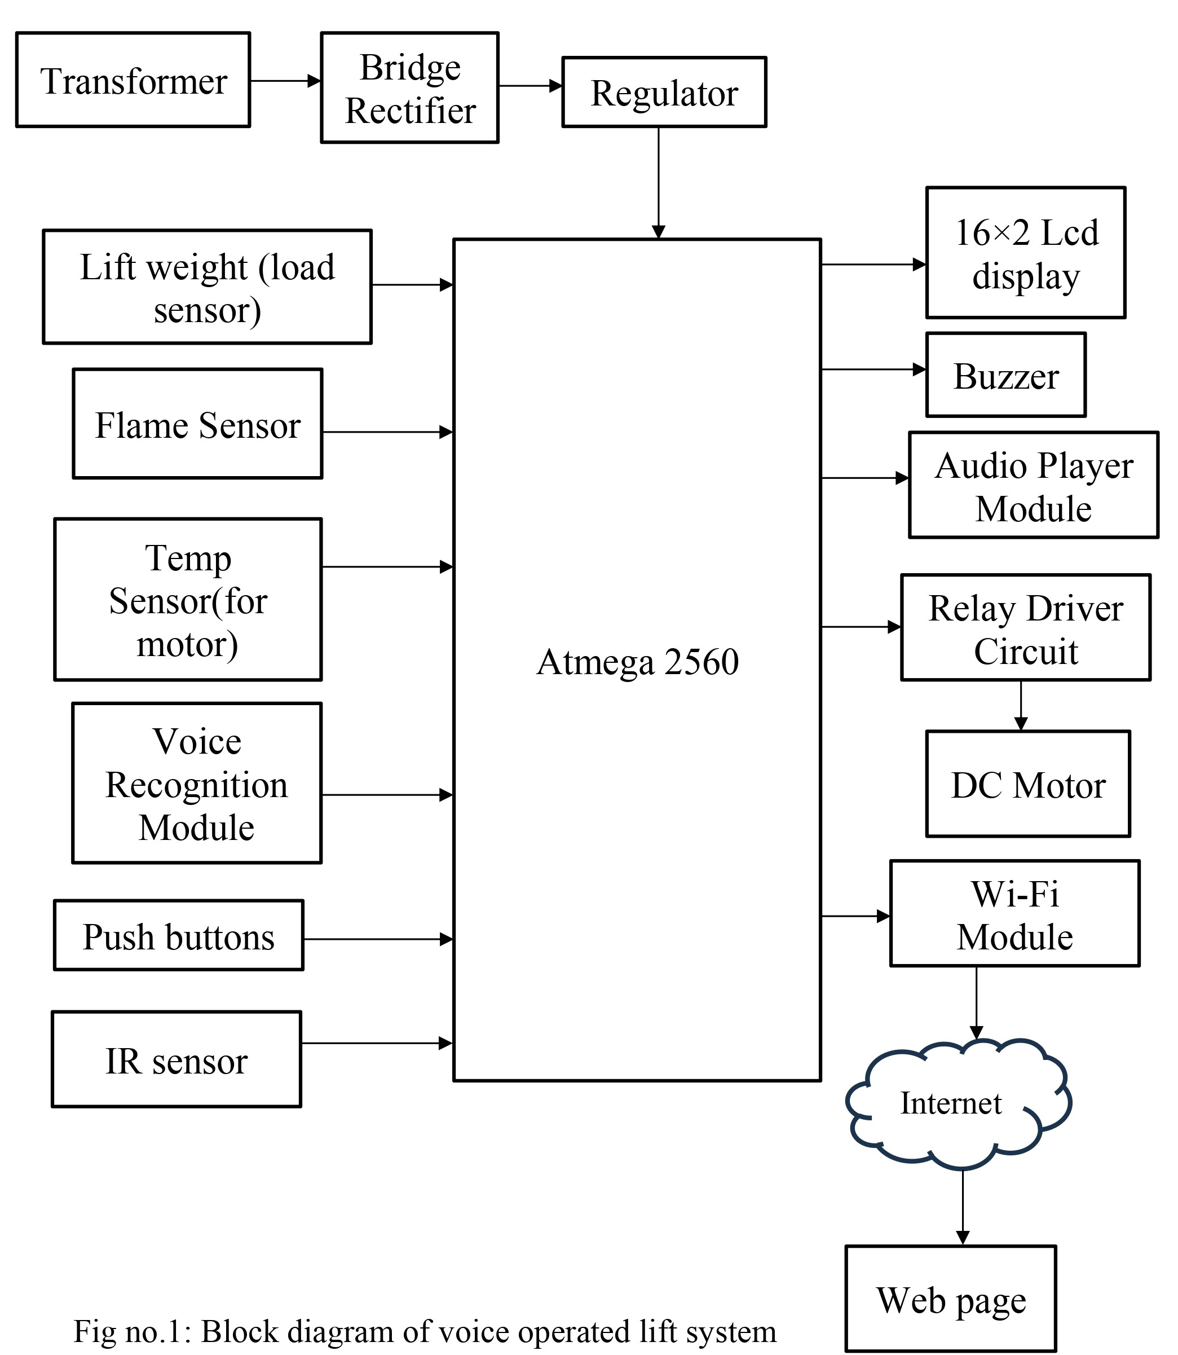
Block Diagram

Slide 11
Explanation of Block Diagram
Transformer: Steps down the AC mains voltage to a suitable level for the rest of the system.
Bridge rectifier: Converts the AC voltage from the transformer to DC.
Regulator: Provides a stable DC voltage to the system, even if the mains voltage fluctuates.
Voice recognition module: Converts the user's spoken commands into text.
Atmega 2560 microcontroller: The brain of the system, which controls all of the other components.
16x2 LCD display: Displays the current floor number and other system information.
Buzzer: Provides audible feedback to the user.
Audio player module: Plays audio cues, such as "Going up" and "Arrived at your floor."
Relay driver circuit: Controls the DC motor.
DC motor: Drives the lift car up and down the shaft.
IR sensor: Detects the current floor number.
Lift weight (load sensor): Monitors the weight of the lift car and prevents it from being overloaded.
Flame sensor: Detects fires in the lift shaft.
Temp sensor (for motor): Monitors the temperature of the lift motor and prevents it from overheating.
Wi-Fi module: Connects the system to the internet.
Internet: Allows the system to be monitored and controlled remotely.
Web page: Provides a user interface for monitoring and controlling the system remotely

Slide 12
Hardware and Software Requirements
H/W requirements:
Atmega 2560 microcontroller
Regulator
Load sensor
Flame Sensor.
Temp sensor.
Voice recognition module.
Push buttons
16×2 Lcd display
Buzzer
Audio player module
Relay
DC motor
Wi-Fi module
S/W requirements:
Arduino IDE
PCB wizard
Web page (using Html, CSS, JS)

Slide 13
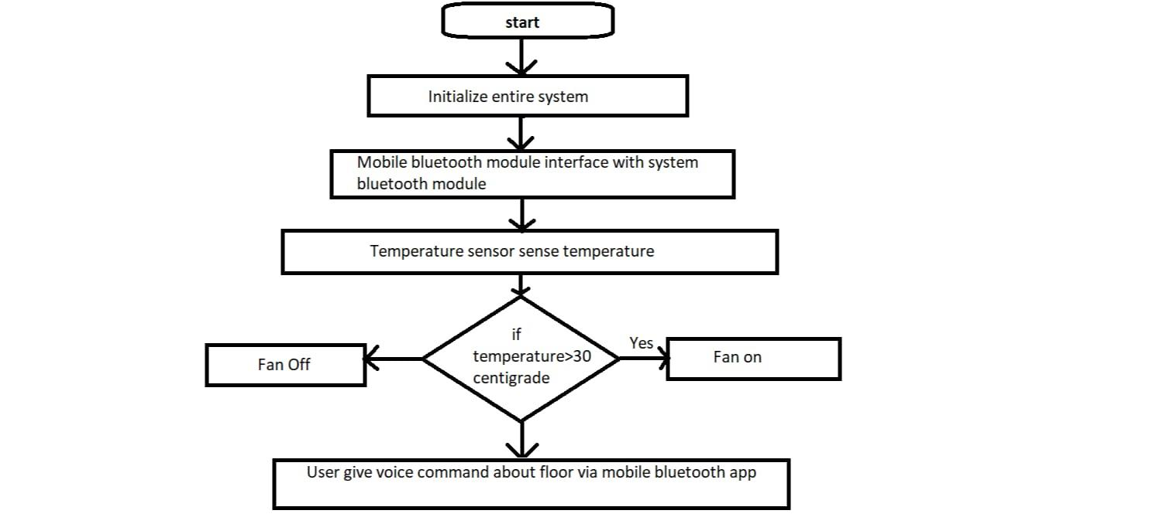
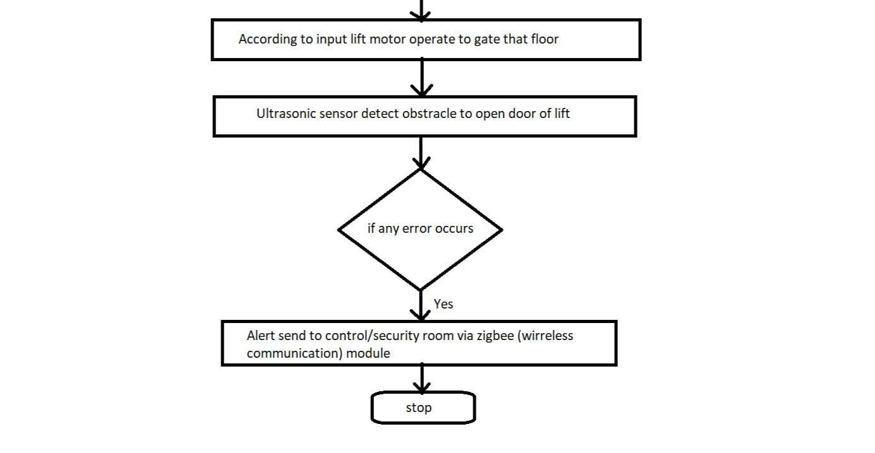
Flow chart
ekda he check kr

Slide 14
Detailed Algorithm
Initialize the system.
Listen for a voice command from the user.
Convert the voice command to text using the voice recognition module.
Determine which floor the user wants to go to based on the text command.
Send a signal to the relay driver circuit to activate the DC motor in the desired direction.
Monitor the current floor number using the IR sensor.
When the lift car reaches the desired floor, send a signal to the relay driver circuit to deactivate the DC motor.
Play an audio cue to inform the user that they have arrived at their destination.
Repeat steps 2-8 until the system is shut down.

Slide 15
Conclusion
Voice-controlled elevators are a long-term solution that can be used by anyone, including people with disabilities. They have the potential to make life easier for everyone and reduce the spread of germs.
In addition to the benefits mentioned above, voice-controlled elevators could also be used to improve security and convenience. For example, authentication could be used to restrict access to certain floors, and sensors could be used to reduce the need for users to give specific commands.
Voice-controlled elevators have a wide range of potential applications, including in homes, offices, hospitals, hostels, and public places.
Overall, voice-controlled elevators are a promising technology with the potential to improve our lives in many ways.

Slide 16
References
Dilip Mathuria, Aditya Gaur, Ashish Gupta, “FPGA Implementation of Biometric based Elevator Controller”, IJETSR Volume 5, Issue 3, March 2018
Farouk Salah Mohamed Saod, Dr Maher Abdel Aziz, “Elevator for blind people using voice recognition” International Journal of Scientific & Engineering Research vol 9 Issue 7,July 18
Kaladharan N, Assistant Professor ,Dept. of Electrical Engineering. Annamalai University, IJIRCCE, “A study of speech recognition” volume.3,issue 9,page 8030- 8034,September 2015.
Komal Mahajan, Riddhi Nahar, Dhanali Khairnar, Shrutika Kinge, Sujata Suryawanshi, “Elevator Control Using Speech Recognition for People with Physical Disabilities” IJARIIE Vol-7 Issue-3 2021
Rashmi P C, Amulya, A Karthik Shetty, “Voice Operated Intelligent Lift” JETIR February 2019, Volume 6, Issue 2
Thomas Mohan, Amrutha K, Anjana Anil Kumar, Helen Johson, Silsha K,“Voice Operated Intelligent Lift”, IRJET VOL. 05 Issue.06 June 2018.
Malim Huzaifa Salim, Sami Jaitapkar, Faki Ziyaan, Kazi Ibrahim, “Voice Based Lift Control” IJRASET Volume 10 Issue V May 2022

Slide 17
P.Cernys, V.Kubilius, V.Macerauskas, K.Ratkevicius, “Intelligent Control of the Lift Model” IEEE international Workshop on Intelligent Data Acquisition and Advanced Computing System: Technology and Applications 8-10 September 2003
Aishwarya Pokharkar, Niriksha Poojari, Harish Pawar , Amey Patil, “Voice Operated Elevator” IJISRT Volume 6, Issue 5, May – 2021
B. Swathi, Akshay S Prathap, Aiswarya V Kumar, Ranjitha R, Raviteja Kaki, “Implementation of Voice based Touchless Lift System” IJSRCSEIT Volume 7, Issue 4, July-August-2021
Datasheet of Atmega 2560 microcontroller.

Slide 18
Thank You!!!

